Slide 1



Swarm Robot
Name Abdulalem Ali Almaeesh
1714949

Slide 2


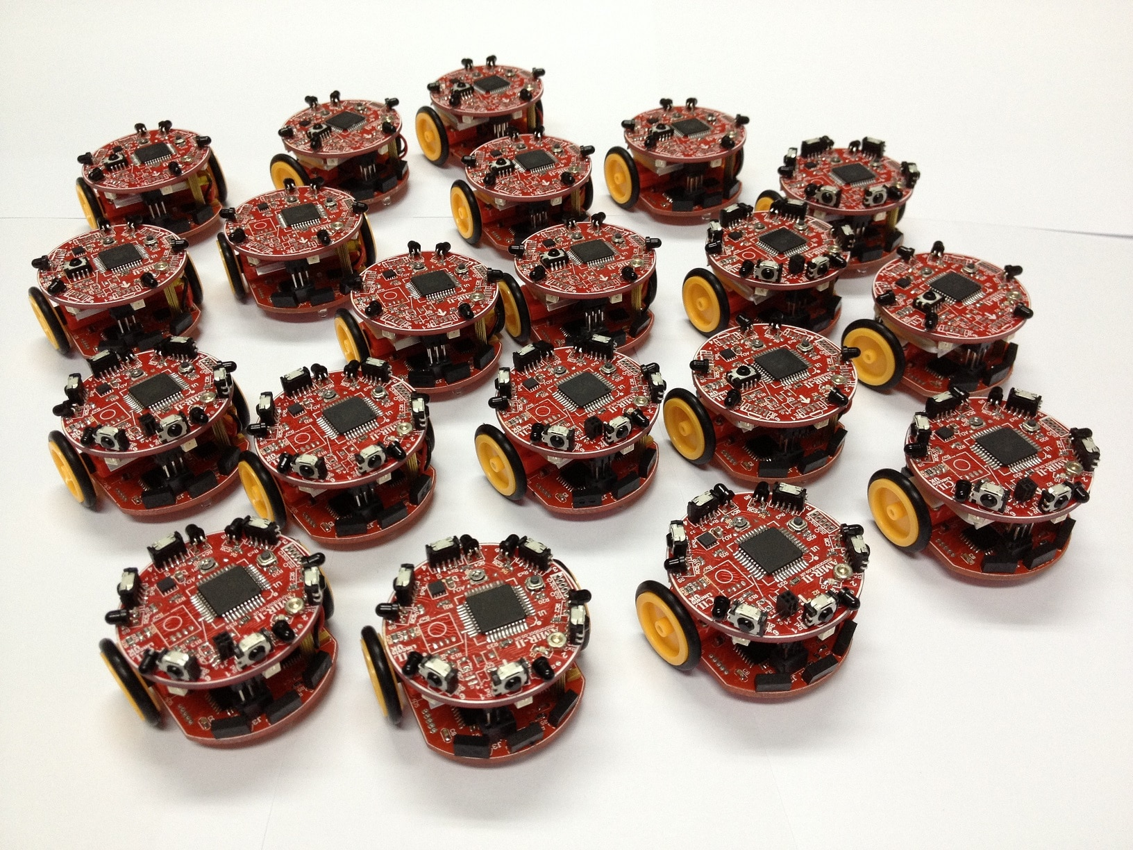

History of the robot
A robot swarm is a self-organizing multi-robot system characterized by high redundancy. Robots’ sensing and communication capabilities are local and robots do not have access to global information. The collective behavior of the robot swarm emerges from the interactions of each individual robot with its peers and with the environment. Typically, a robot swarm is composed of homogeneous robots, although some examples of heterogeneous robot swarms do exist​

Slide 3


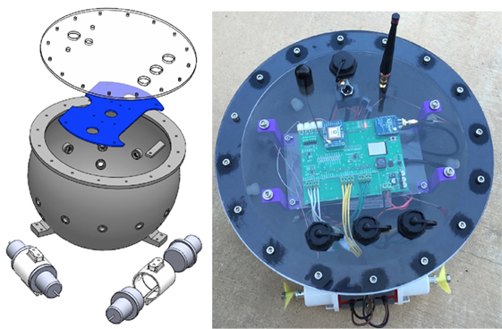
System arcticture

Slide 4
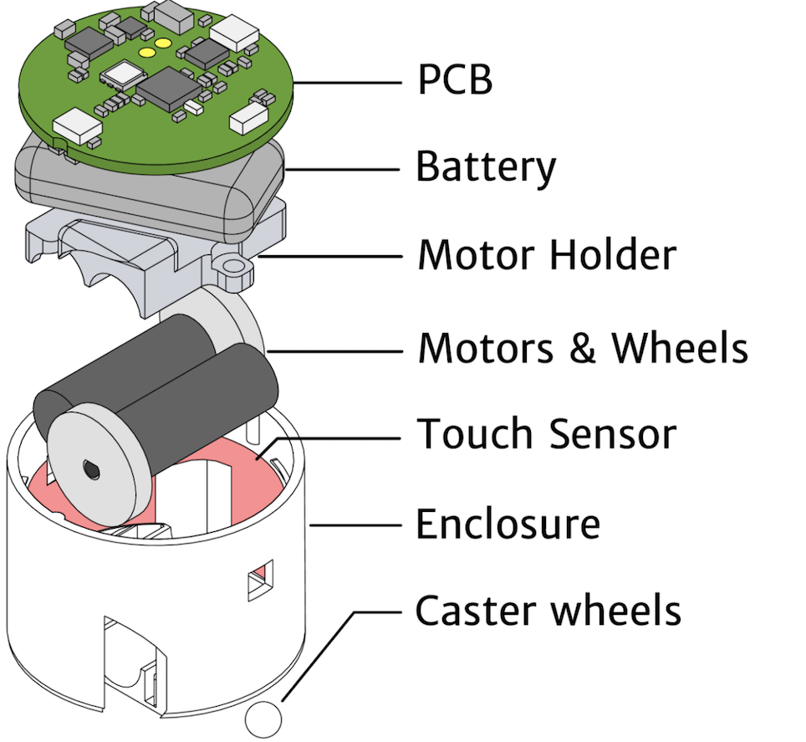
Robot Design and mission
An 8-bit micro-controller from Atmel to be chosen
as the brains of each robot, this 8pin chip is simple to program and has enough computing power to achieve
the desired design. A duel H-bridge motor driver chip from Texas Instruments to be used to interface and control
two DC motors for movement. A combination of and not gate array chips will act as I/O extenders so
as to free pin on the chip for other uses. A combination of several IR transmitter diodes, a single IR receiver
diode and two limit switches are used for sensing and interacting with the environment.

Slide 5
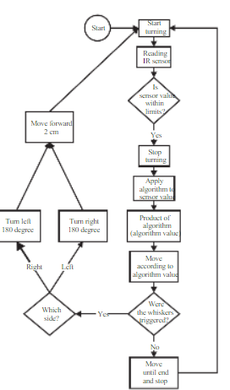
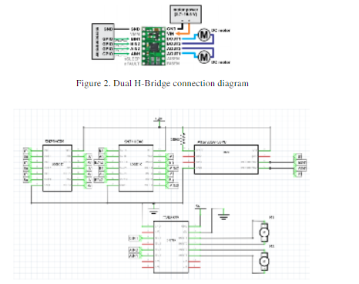

Flowchart

Slide 6

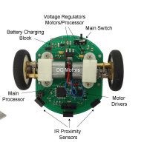
Actuators and Locomotion
TT" gearbox motor are popular
These motors are being used in building mobile robot, example in one of Cytron Mobile Robot Kit for RBT

Slide 7
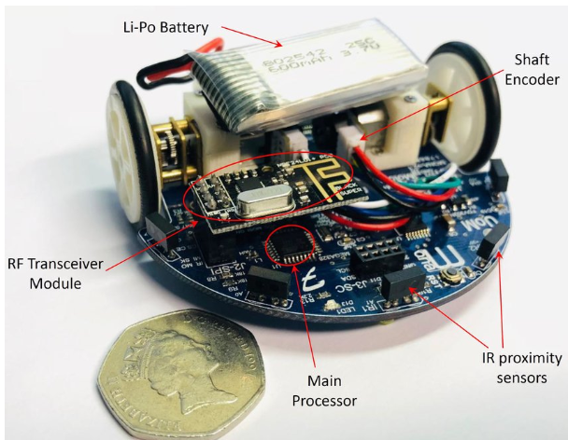
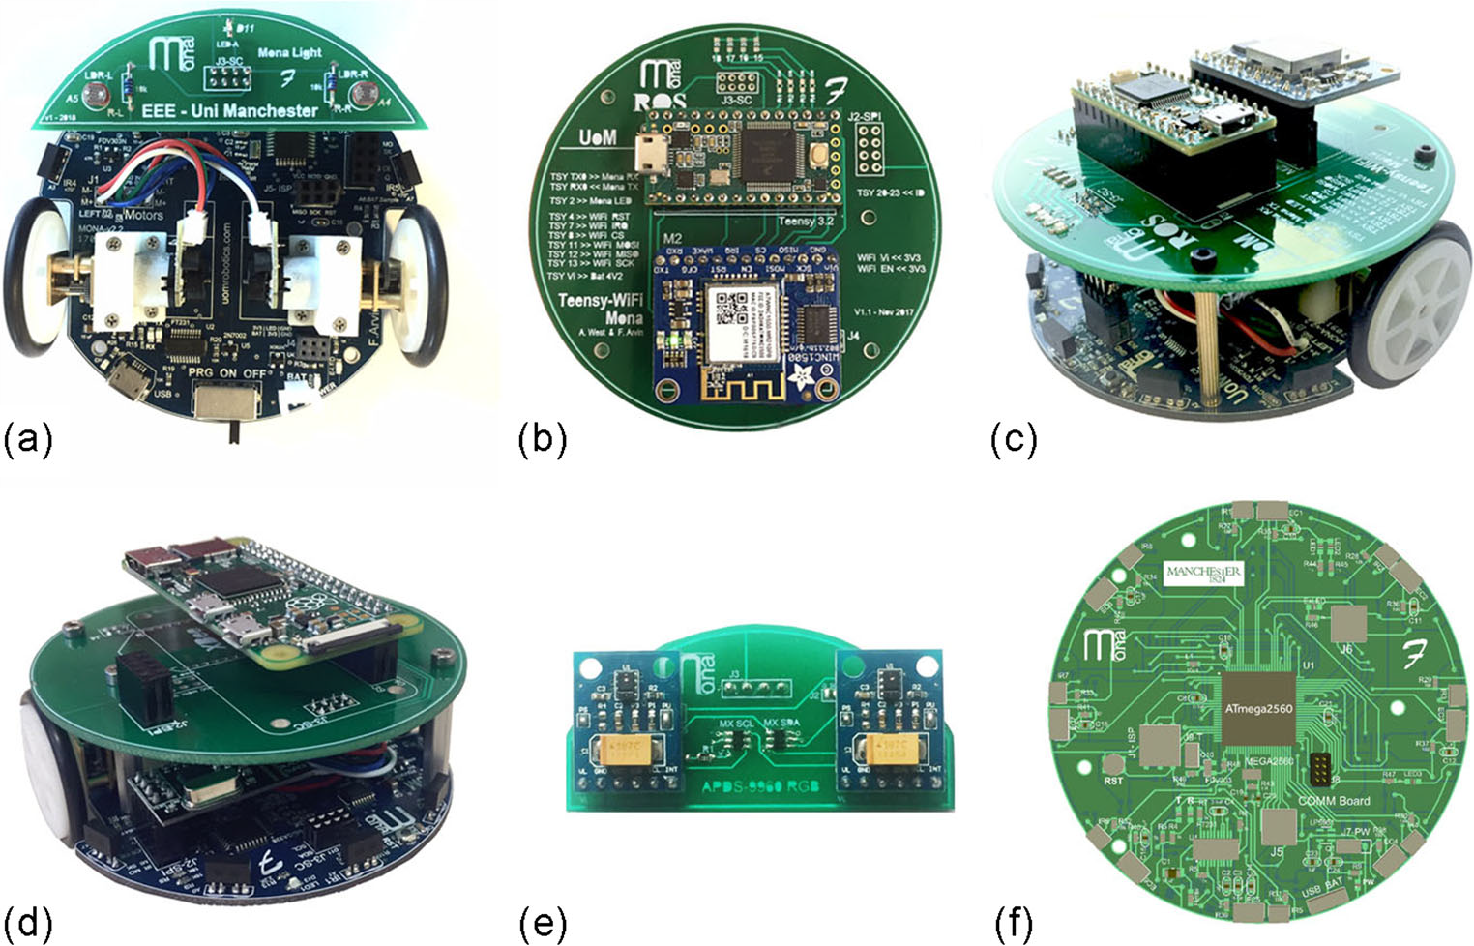
Navigation System and Controller

Slide 8
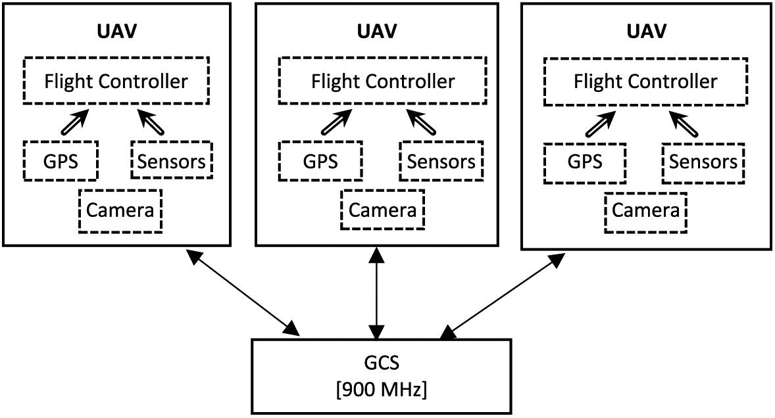
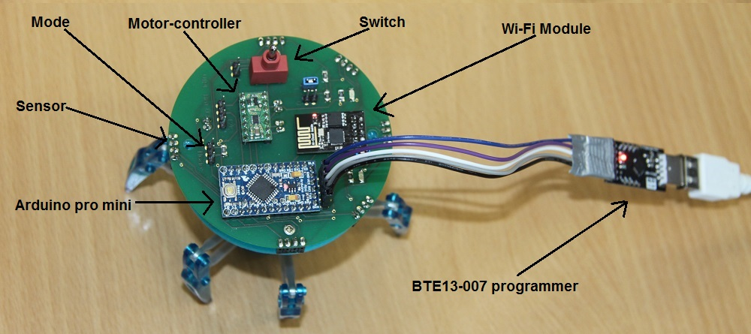
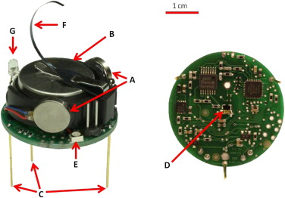
Data Collection and Data Transmission

Slide 9
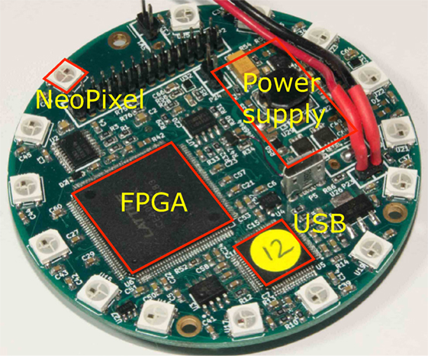
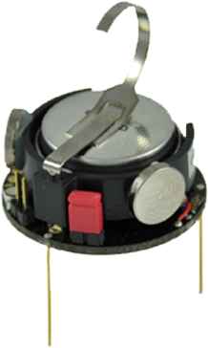
Power system

